Slide 1

____________________
CSDT Virtual Bead Loom
6 May 2008
Final Presentation for Software Engineering

Slide 2
Members
Team Organization
Member | Title | Responsibilities
Chris Hollis | Chief Programmer / Team Lead / Software Engineer | Designs, Implements critical parts and makes major decisions / Designer/ Analyst/ Tester/ Trainer
Chris Blake | Understudy/ Administration/ Tester/ Programmer | Substitutes for chief programmer/ Record executive meetings / Designer/ Analyst/ Tester/ Trainer
Joe Petrizzi | Librarian / Administration/ Tester | Maintains all project documentation/ Recorder/ Analyst/ Configuration management/ Tester
Michael Lodge | Programmer | Requirements Analyst/ Programmer/ Tester
Phillip Gipson | Programmer | Requirements Analyst/ Programmer/ Tester

Slide 3
Outline
Documentation Overview
Background Information about CSDT
Documentation
System Specification
Feasibility Study
Software Project Plan
Software Requirements Specification
Software Design Specification
Software Verification and Validation
Summary
References

Slide 4
Background
What is CSDT?
Cultural-Situated Design Tools
Software designed to help accustom students of grades 6 through 12.
Accomplishes its goal by allowing the students to interact with a digital bead loom
Recreate the types of looms Native Americans are known to have made.
The Clients
Dr. Ron Eglash
Dr. Tiffany Barnes
Dr. Mukkai Krishnamoorthy

Slide 5
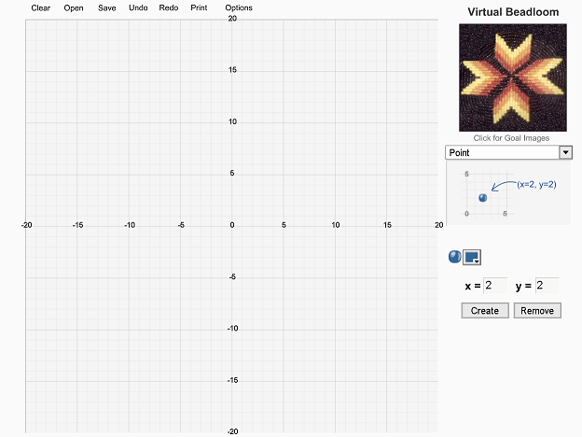
Background
http://www.ccd.rpi.edu/Eglash/csdt/na/loom/software/index.html
Flash Version
“Convert Flash into a more universal, friendly,
and flexible environment, Java. In essence,
this will be a ground-up “redesign”
of what exists now.”
-CSDT Project Proposal (Introduction)

Slide 6
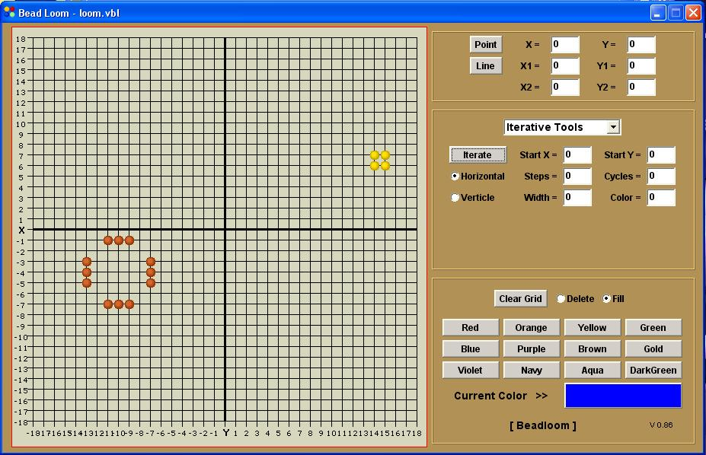
Background
Old Java Version
We were given an old java applet prototype as a reference
Differences between prototype and flash
What does and does not work
How Team Ramrod corrected and added extra features

Slide 7
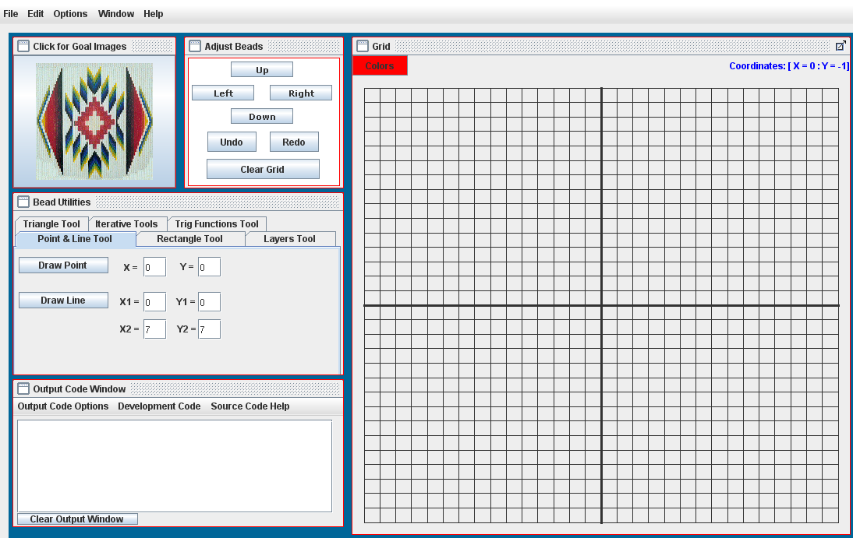
Background
New Java Version
Newly added Features
Why Graphical User Interface change?
Windows and Macintosh environement

Slide 8
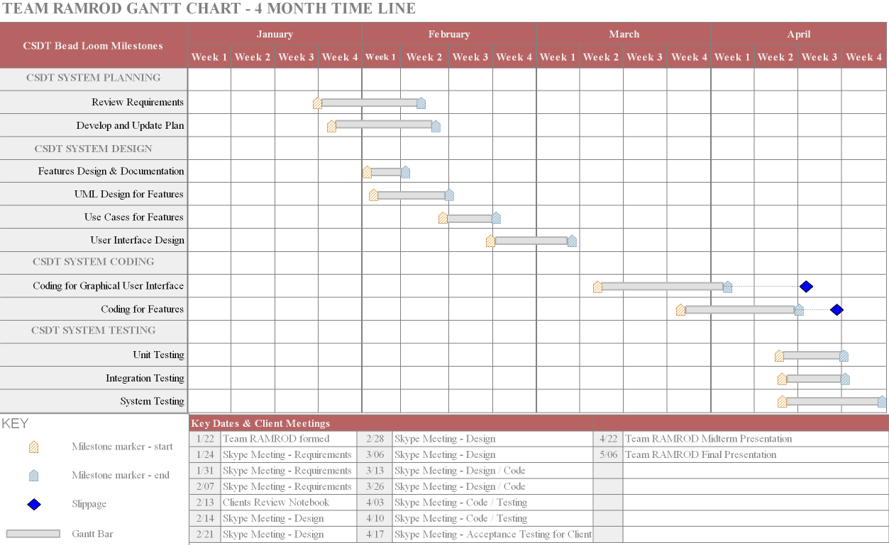
Timeline

Slide 9
Timeline
Date Started | Date Finished | Document
22-Jan-2008 | 29-Jan-2008 | System Specification, Feasibility Study, Project Plan
1-Feb-2008 | 2-Feb-2008 | Feature Documentation
3-Feb-2008 | 6-Feb-2008 | Combined Features w/Use Cases, Abstracts
5-Feb-2008 | 12-Feb-2008 | Requirement Specification, Design Specification, Preliminary User’s Manual
25-Feb-2008 | 8-Mar-2008 | Software Verification and Validation Plan
27-Mar-2008 | 5-Apr-2008 | Implementation Verification and Validation
3-Apr-2008 | 6-Apr-2008 | Revised Software Verification and Validation Plan
7-Apr-2008 | 12-Apr-2008 | Revised Implementation Verification and Validation & Software Verification and Validation Plan
8-Apr-2008 | 19-Apr-2008 | Preliminary Notebook, Revised User’s Manual, Project Legacy

Slide 10
Software System Specification
Understanding the System
What is the System Specification?
Allows a large majority to understand and use the system.
To give the customer a record of the software's system requirements
To implement the needed requirements for enhancing the CSDT.
Why?
To ease further development.
To module usage and system interconnectivity.
System was developed keeping the original system specifications in mind

Slide 11
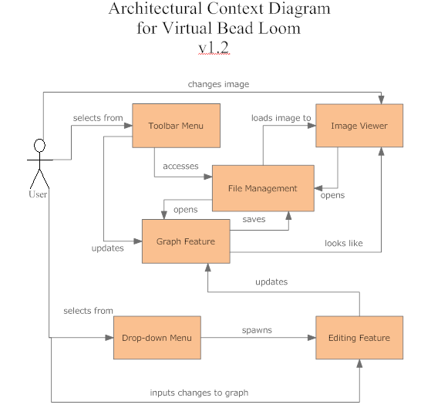
Software System Specification
Understanding the System
Evaluated the Flash and Old Java Prototype
Diagram created early during the Requirements Phase
Drop-Down Menu changed to Bead Utilities

Slide 12
Feasibility Study
What is feasibile?
The Feability Study
A preliminary analysis of what requirements can or cannot be achieved
To get the most important and desired features implemented first
Determined by keeping in constant contact with the clients
When and What?
Conducted late during the requirements analysis milestone, but…
An ongoing process to ensure satisfied clients

Slide 13
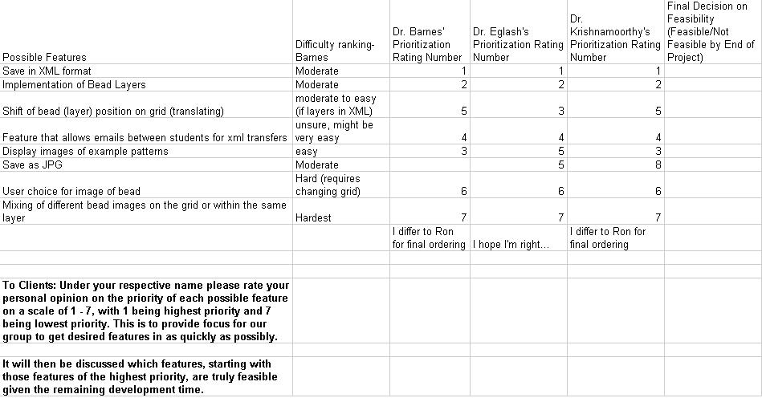
Feasibility Study
The Feasbility Report
Document created to prioritize what can be feasible

Slide 14
Feasibility Study
What can or cannot be feasibile?
Goals that the team determined feasible
GUI…
XML…
Layers…
Undo, Redo, Print, Iterations….
Goals that the team determined not feasbile
Implementation of Pseudo Code execution
XML E-Mail Feature
Non-Negative Grid

Slide 15
Software Project Plan
Developing a plan
What is the plan?
Identifies what is to be accomplished in the project…
To provide the customer an estimation
How much the project will cost and take
Techniques, Analysis, Risk, Changes
Developed during the Requirements and Analysis Phase.
Computed based on perceived team ability
Models to estimate risk, feasibility, size, and time cost (COCOMO II)
Plan changed considerably early on due to miscommunication and misinterpretations

Slide 16
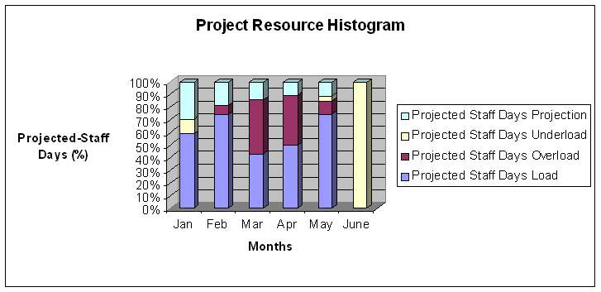
Software Project Plan
Resource Histogram Estimation
Early estimation for staff
March and April Overload
June – No staff Load

Slide 17
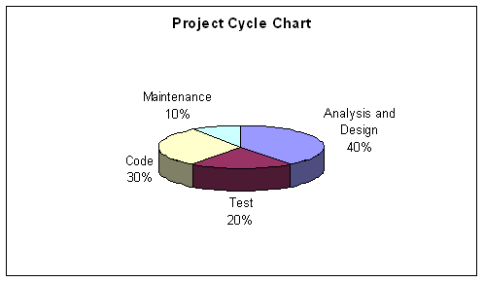
Software Project Plan
Project Life Cycle
Early Estimation of Life Cycle

Slide 18
Software Requirements Specification
Evaluating the Requirements
What are the requirements?
The purpose of this document (User Scenarios, diagrams, descriptions, etc…)
Why is this document needed? (Describing the System)
Requirements dictated by the Clients…
Phases and Features
Started in the Requirements Phase, slipped into Design Phase
Main features included in the specification…(Menu Bar, Graph, Bead Utilities, etc…)

Slide 19
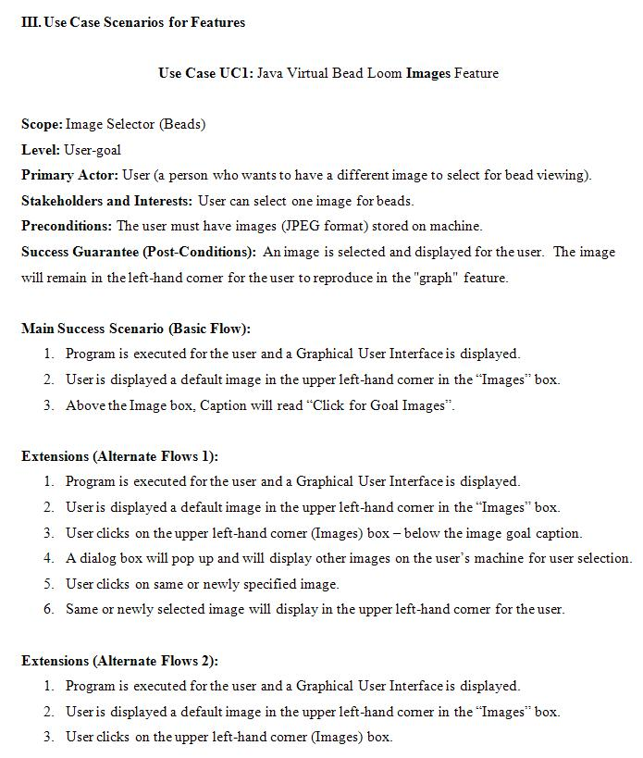
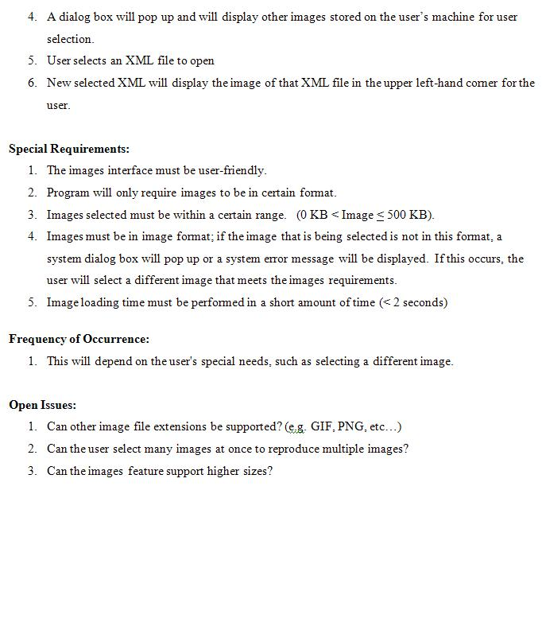
Software Requirements Specification
User Scenarios

Slide 20
Software Design Specification
Designing the System
The Design Process
To create a design for the system that correlates with the requirements given by the clients
What happens when the purpose and specifications of software is determined…
Document created and finished in the Design Phase
UML Diagrams
The purpose of having modeling diagrams
UML Sequence Diagrams for features (Understanding)
UML Class Diagrams for overall system (Understanding)

Slide 21
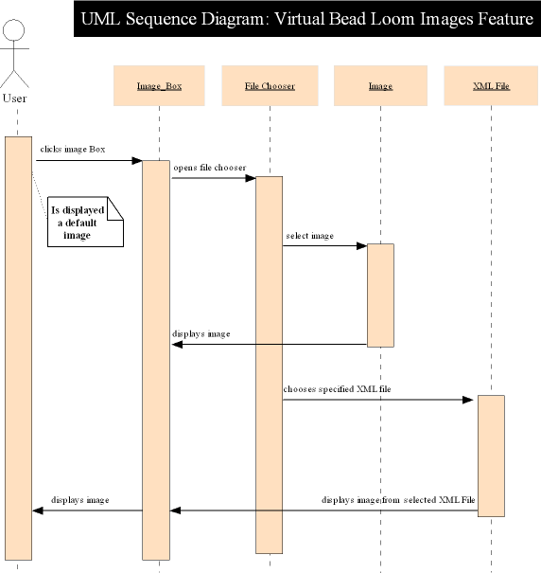
Software Design Specification
UML Sequence Diagram

Slide 22
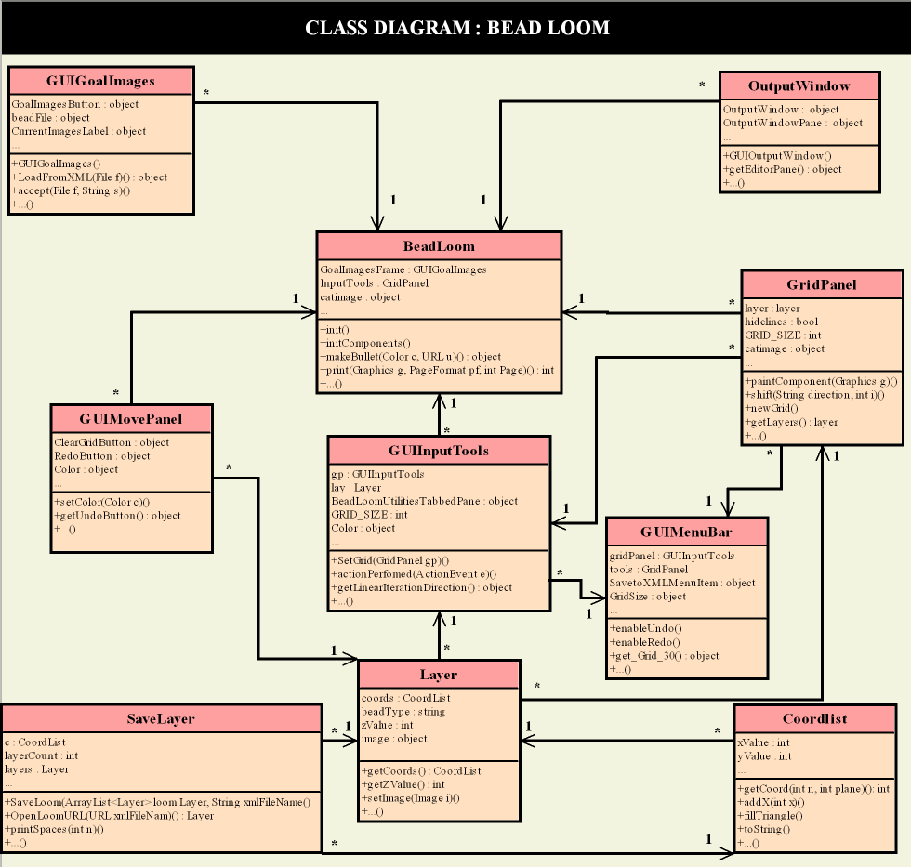
Software Design Specification
UML Class Diagram

Slide 23
Software Verification and Validation Plan
SVVP
What is the SVVP and it‘s purpose?
To set out with a plan to begin verification and validation tasks
Clear plans for the project's organization, communication and documentation…
Started in our Design Phase and revised up through the Coding and Implementation Phase
Verification, Validation, Tests...
Verification - "Are we building the product right?"
Validation - "Are we building the right product?"
Provides a type of test for each procedure (Unit, Integration, System)
White-box and Black-box testing

Slide 24
Software Verification and Validation Plan
Testing
Tester Name: (This is the person’s name that is testing the program) | Date: (This is the current date when test is performed)
Time Began: (This is the actual time for start of tests) | Time Ended: (This is the actual end time for ending the tests)
Instructor: (This field can be left blank if there is none) | Program ID: (This is the Testing unit’s ID field for the type of test given)
Program Test Name: (This is the Test name from the Program ID field)
Objective: (Specifies what the tests should perform)
Description: (Specifies a valid description of the type of tests to perform)
Conditions: (A set of conditions for the tests to perform under)
Expected Results: (A set of expected results that the testing should return)
Actual Results: (A set of actual results that the tests returns)
For the unit testing, a report is generated for each type of tests.
Defect logs
Anomaly Reports

Slide 25
Summary
Recap of documentation
Scheduling/Planning (Jan 14 - Jan 21)
Began documenting group/personal logs, executive meetings with clients and instructor
Requirements (Jan 22 – Feb 02)
Began continually eliciting and updating requirements from clients
Formal document development began
Design (Feb 18 – Mar 30)
Preliminary GUI was created based on current requirements
Feature documentation was developed

Slide 26
Summary
Recap of documentation
Coding and Implementation (Mar 7 – Apr 7)
Extensive team coding sessions dominated milestone time
Testing (Mar 31 – Apr 27)
Bugs found through black box testing. Reflected in defect logs Appendix B
HTML embedding issues discovered and resolved

Slide 27
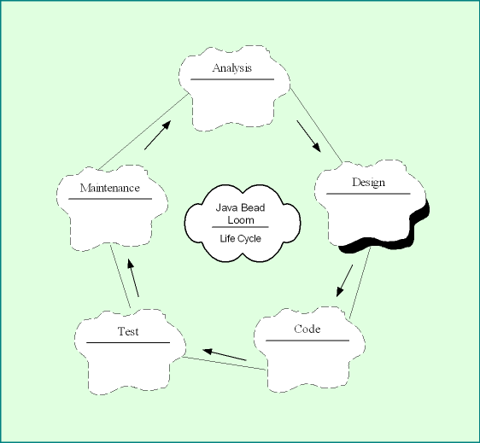
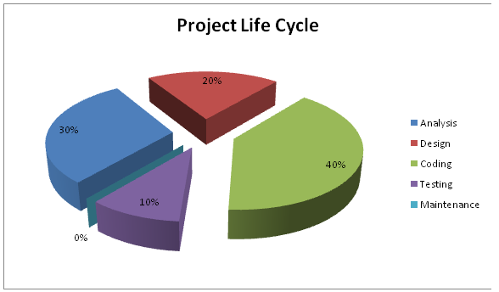
Summary
Diagrams
Picture from XIII Verification and Validation Overview section
Project Plan Document
Figure 4. Project Cycle Chart. Shows a percentage of total project time that will be spent on each phase.

Slide 28
Summary
Tasks for the future
Major & Minor Implementations
Editing Layers (Merging, Colors, etc…)
Output Window Execution and Functionality
XML E-Mail Feature
Non-Negative Grid
Selectable Coordinate Types
Different Bead Images
Reasons
Why are the features not implemented (time)
Deadlines for Milestone Process

Slide 29
References
Manuals, Books, Existing Documentation
Software Engineering: Theory and Practice 3rd Edition, Pfleeger, Shari Lawrence, et al.
The Institute of Electronic Engineers. (1986). IEEE Standard for Software Verification
and Validation Plans. New York
CriTech Research. (1999). Verification and Validation. http://www.critech.com/vv.htm

Slide 30
References
Hardware and Software
Development Environment: Eclipse IDE 5.0 and later
Testing System: Intel Core 2 Duo CPU 6600 @ 2.40GHz, 3.00 GB RAM
Testing Operating System: Windows XP Professional Service Pack 2
Time Management : Recorded on Google Docs
Testing suites provided by: COCOMO II, internally developed white-box suite
Hosting server: Alltel.net

Slide 31
DEMO :]

